Slide 1




DATA MANAGER PRESENTATION
Version 1.0

Slide 2

EmpowerU
Login
Summary
Area
Classification
Program Cycle
User
Report
Resource
Key facts
Import Logs

Slide 3
1
Login

Slide 4
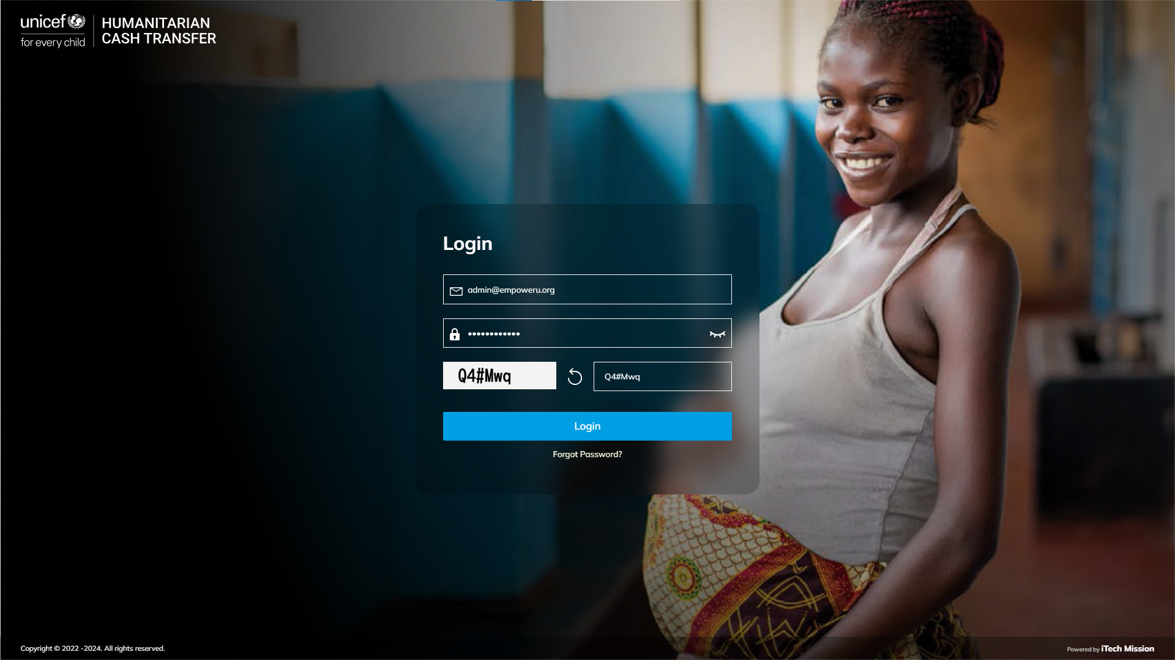
LOGIN
Login using valid credentials to access the Data Manager.

Slide 5
2
Summary

Slide 6
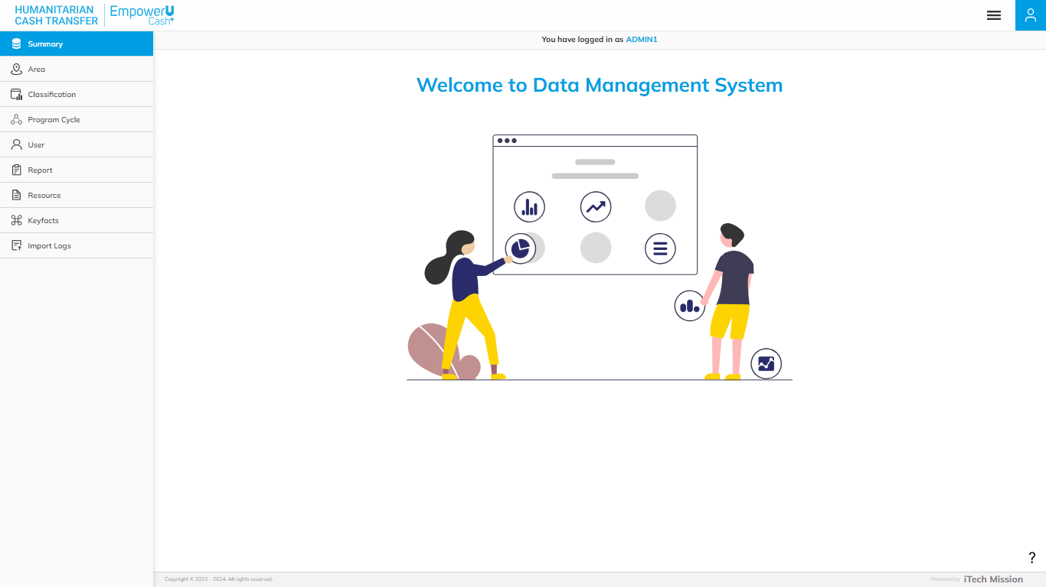
SUMMARY
Welcome Page

Slide 7
3
Area

Slide 8
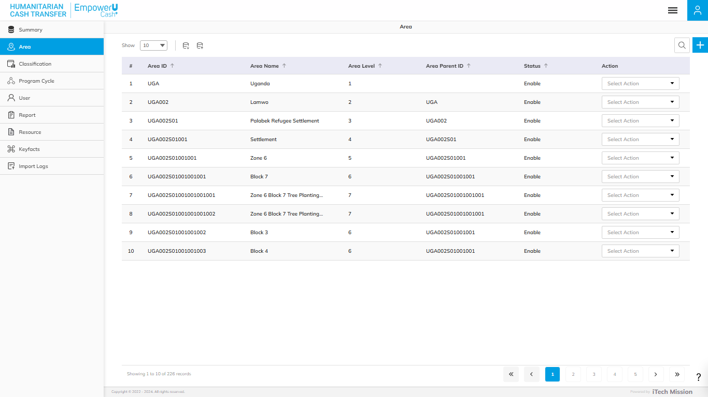
AREA
View and Search the existing Area List. Click on the plus button to add a new area.

Slide 9
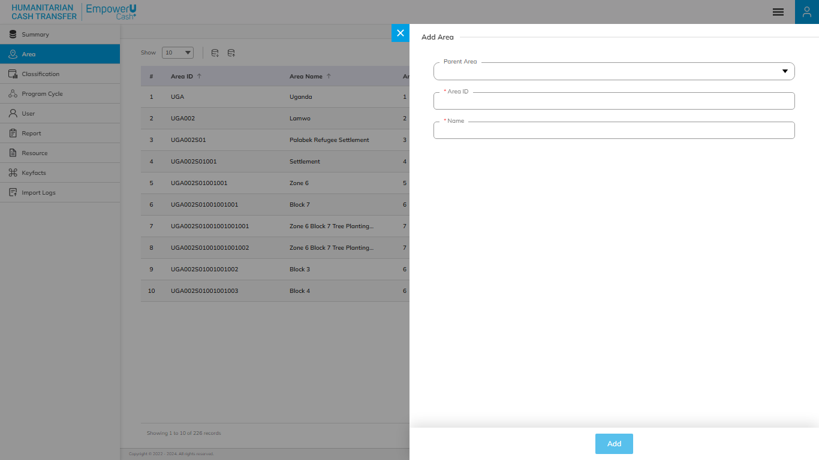
AREA
Add Area Form – Fill in the details – Parent Area, Area ID, and Name. Click Add to confirm & save.

Slide 10
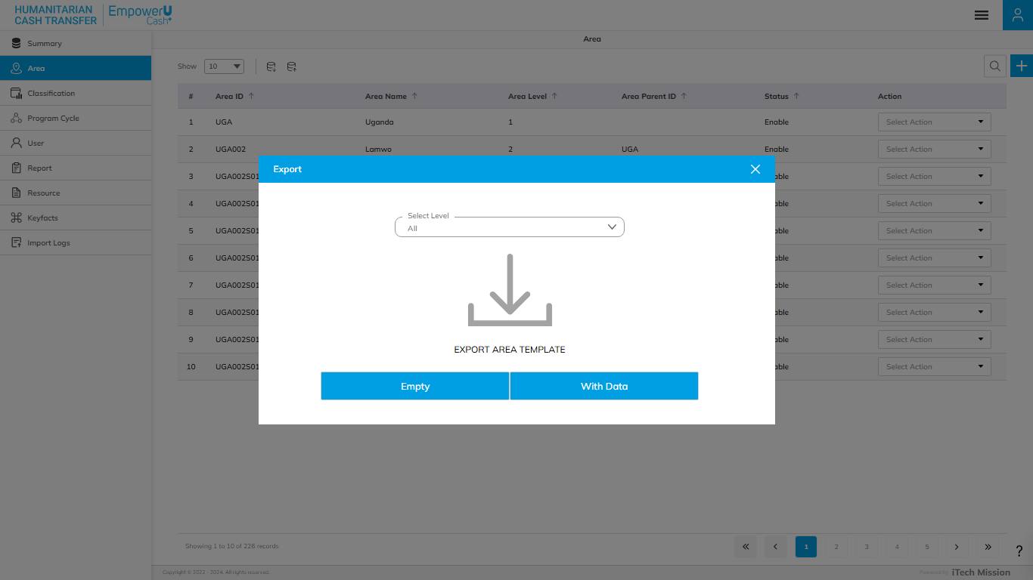
AREA
Click on the Export icon and Select Level to download - Export empty template and existing data.

Slide 11
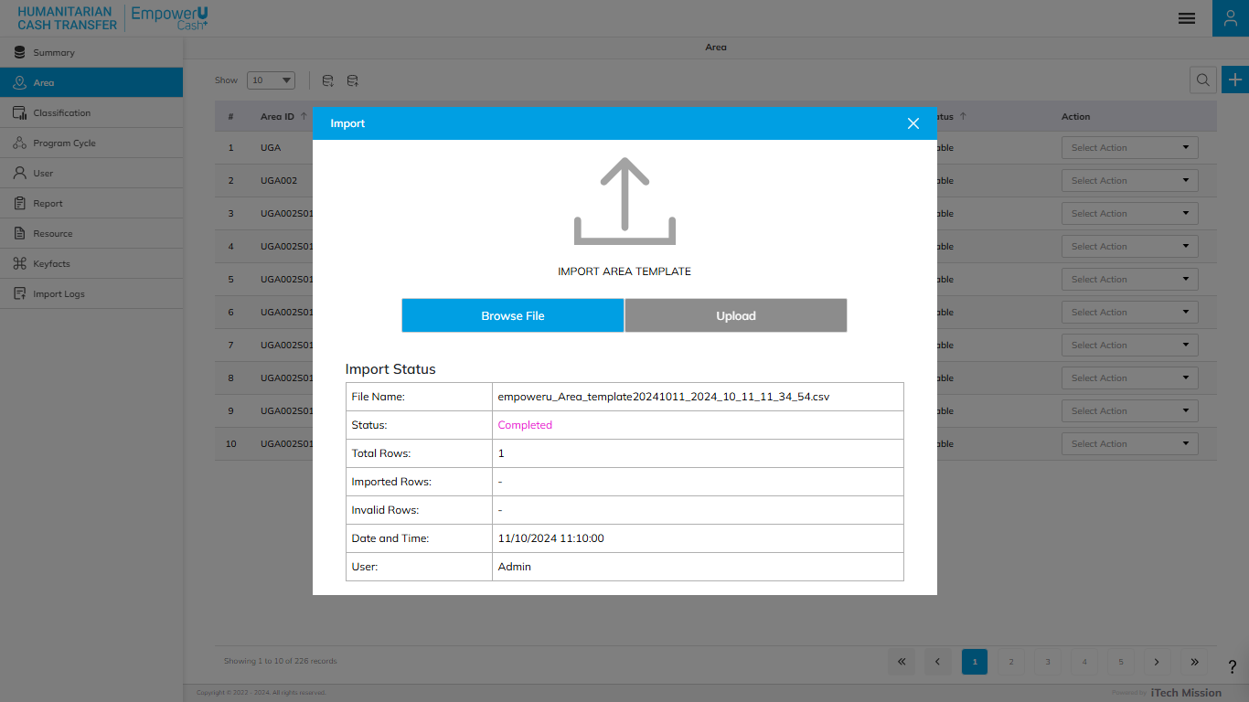
AREA
Click on the Import Icon, Browse the file, and click Upload to import the Area file.

Slide 12
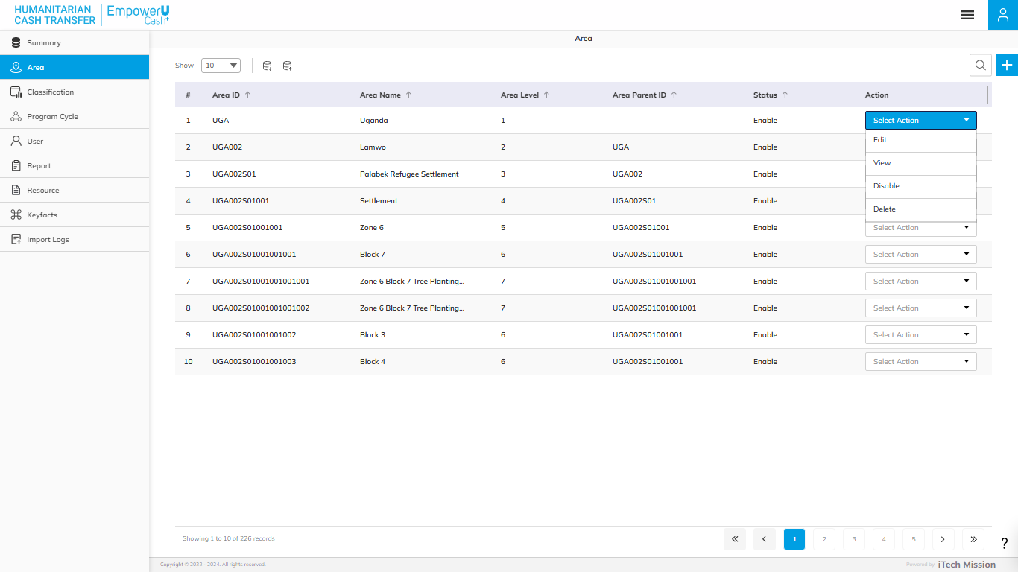
AREA
Edit, View, Enable/Disable, and Delete the existing area.

Slide 13
4
Classification

Slide 14
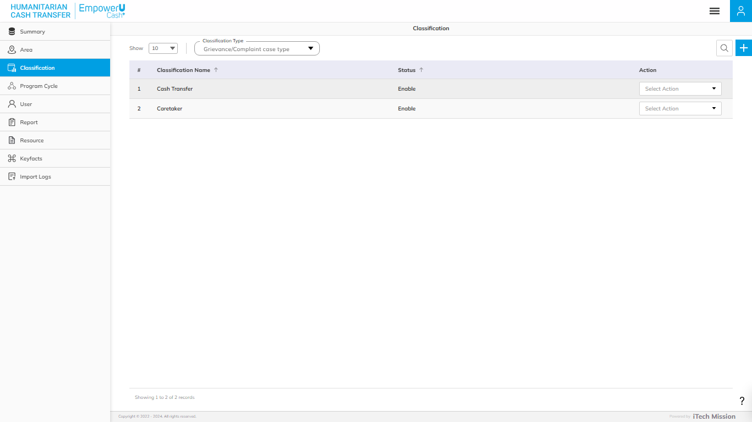
CLASSIFICATION
View and Search existing classifications List for the specific classification Click on the plus button to add a new classification.

Slide 15
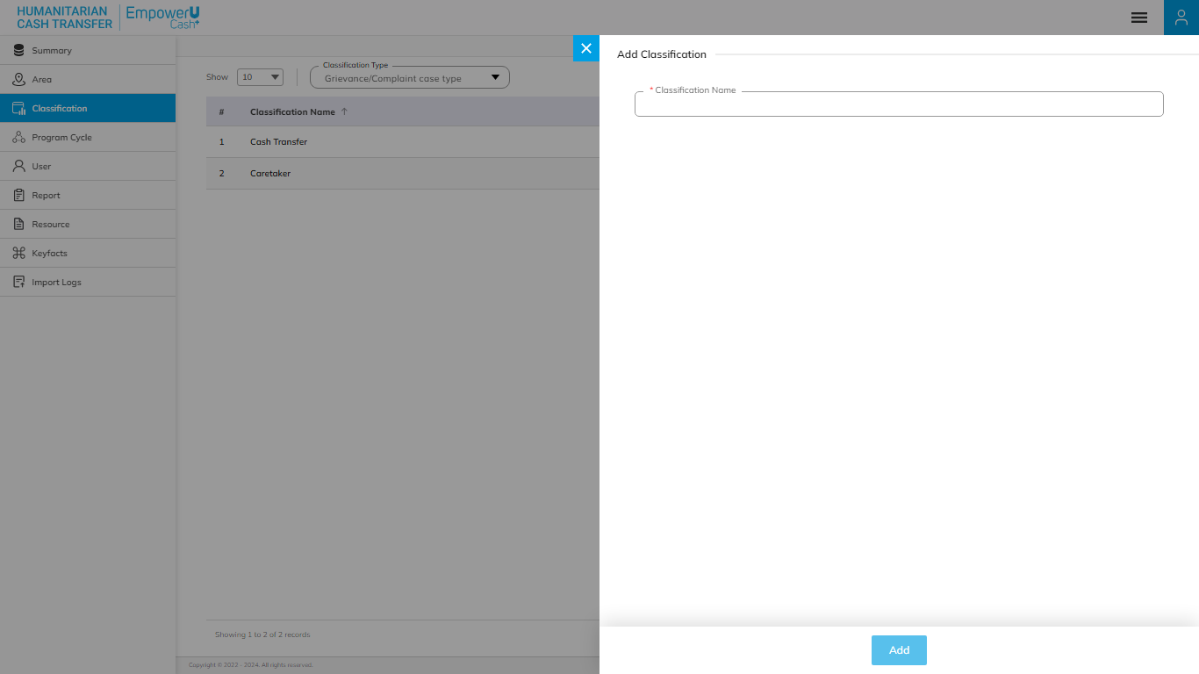
CLASSIFICATION
Add Classification Form – Fill in the details – Classification Name. Click Add to confirm & save.

Slide 16
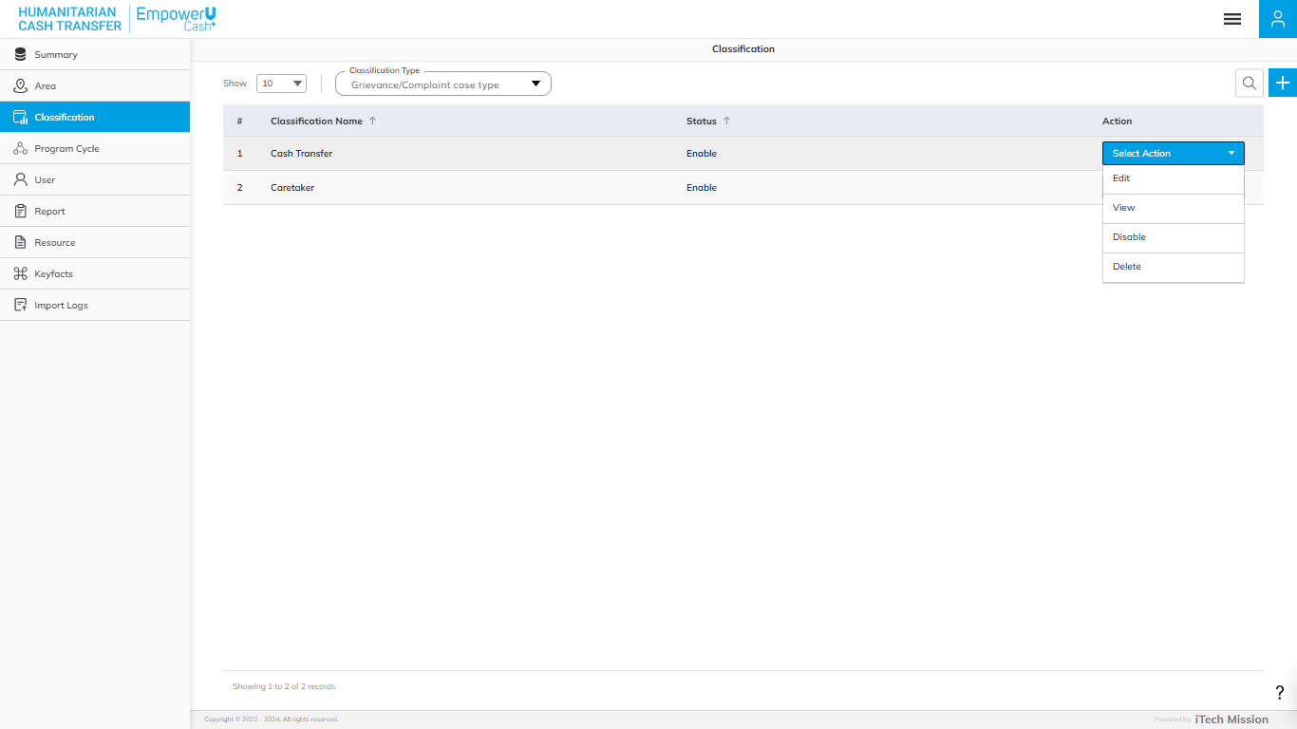
CLASSIFICATION
Edit, View, Enable/Disable, and Delete the existing classification.

Slide 17
4
Program Cycle

Slide 18
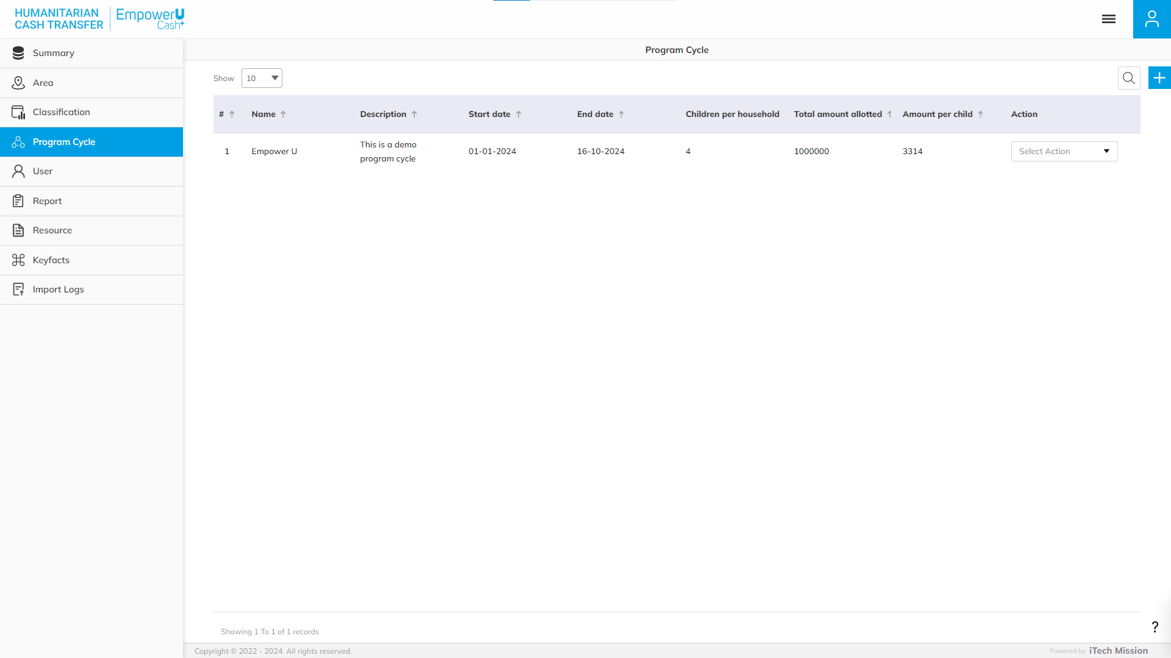
PROGRAM CYCLE
View and Search the existing Program Cycle List. Click on the plus button to add a new program cycle.

Slide 19
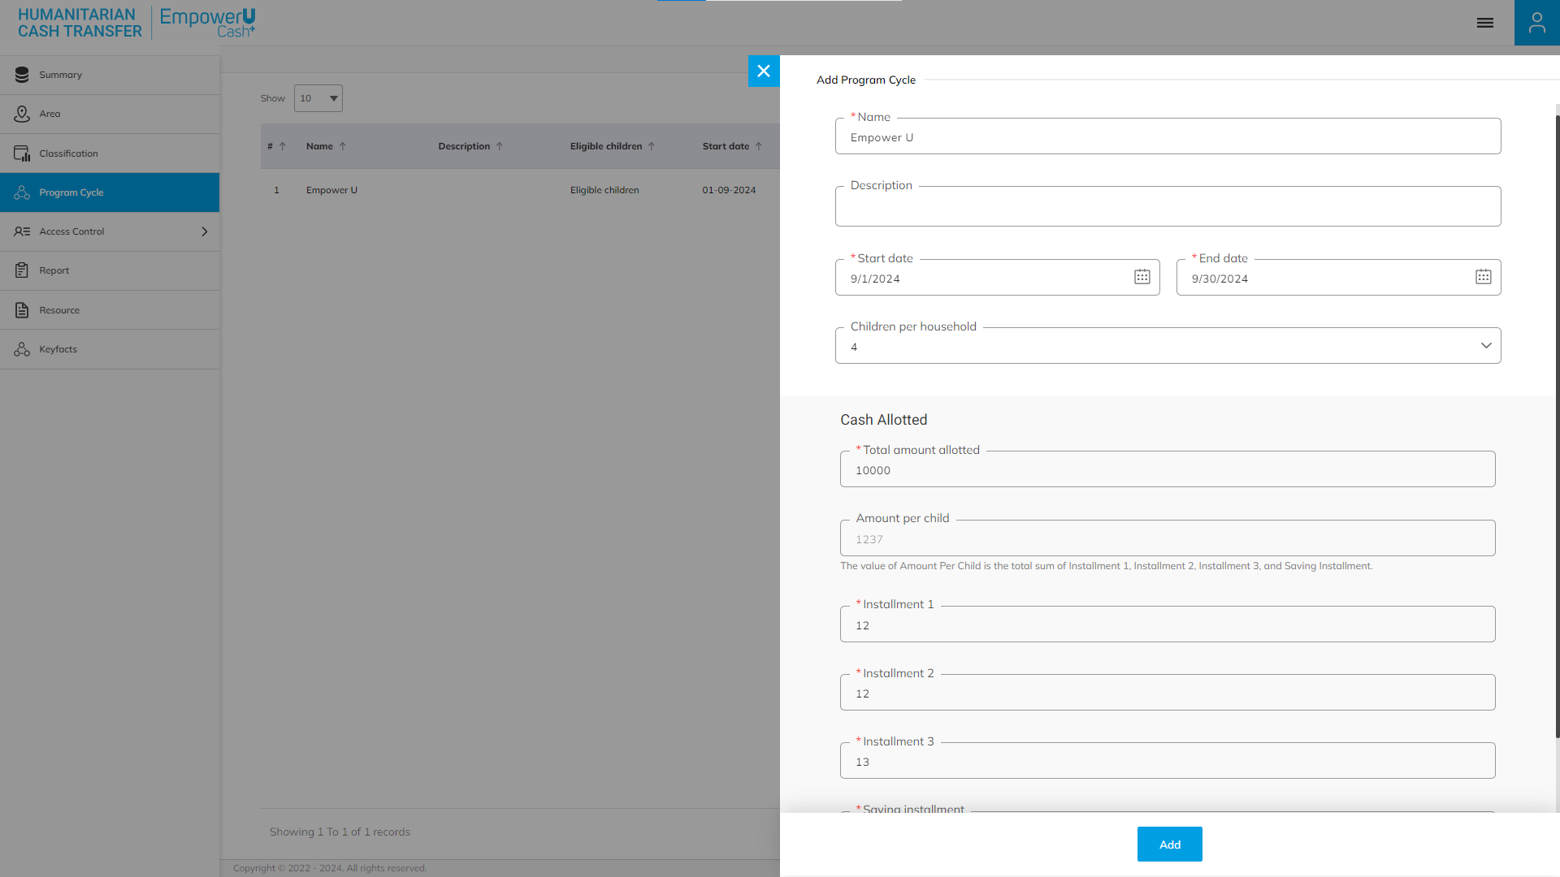
Add Program Cycle Form – Fill in the details – Name, Description, Start Date, End Date, Children Per Household, and Cash Allotment Distribution. Click Add to confirm & save.
PROGRAM CYCLE

Slide 20
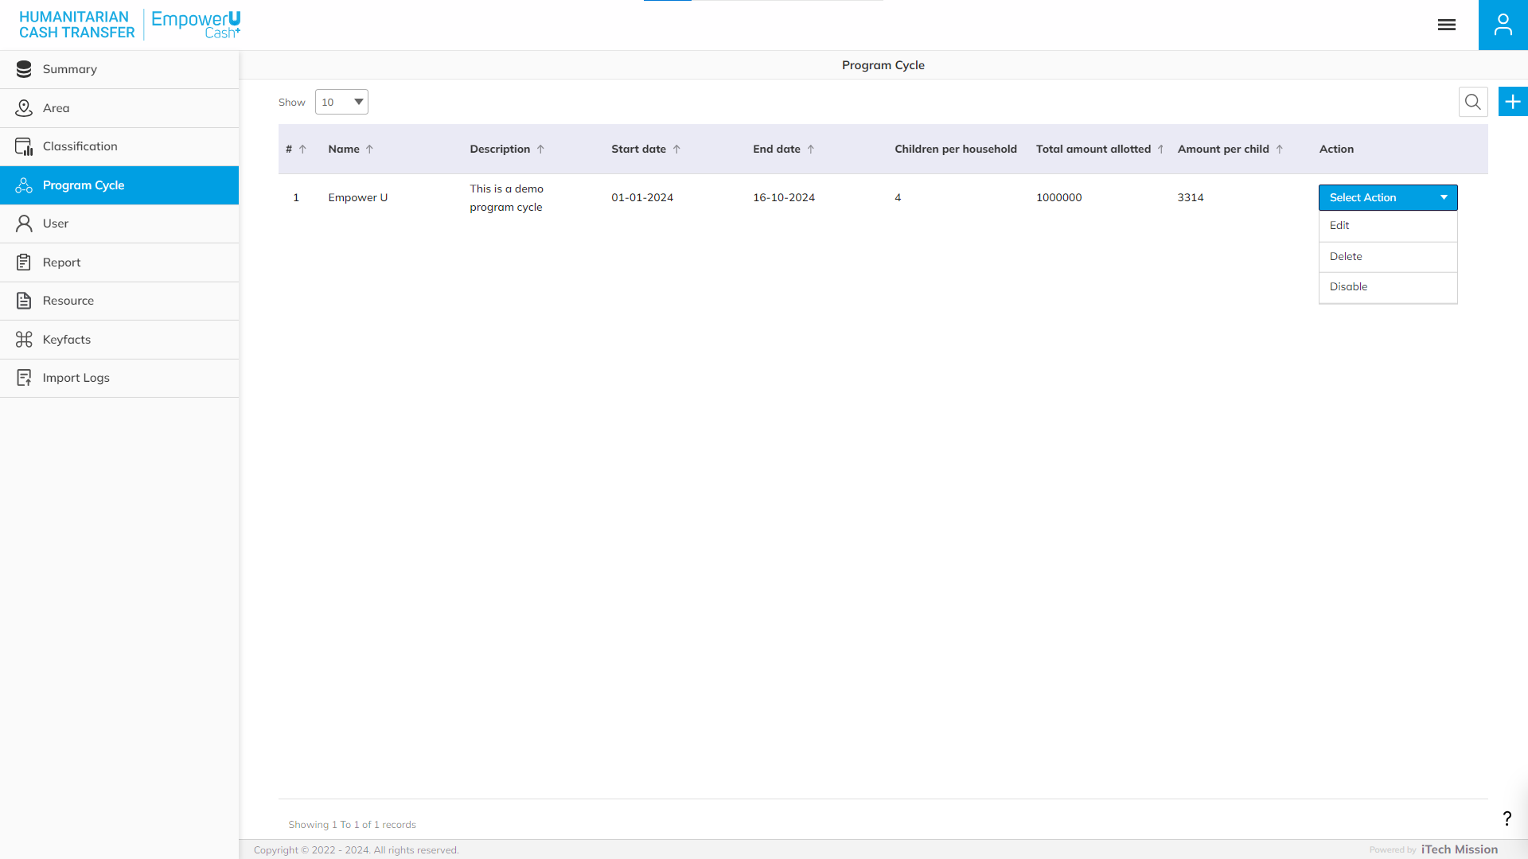
PROGRAM CYCLE
Edit, Enable/Disable, and Delete the existing Program Cycle.

Slide 21
5
User

Slide 22
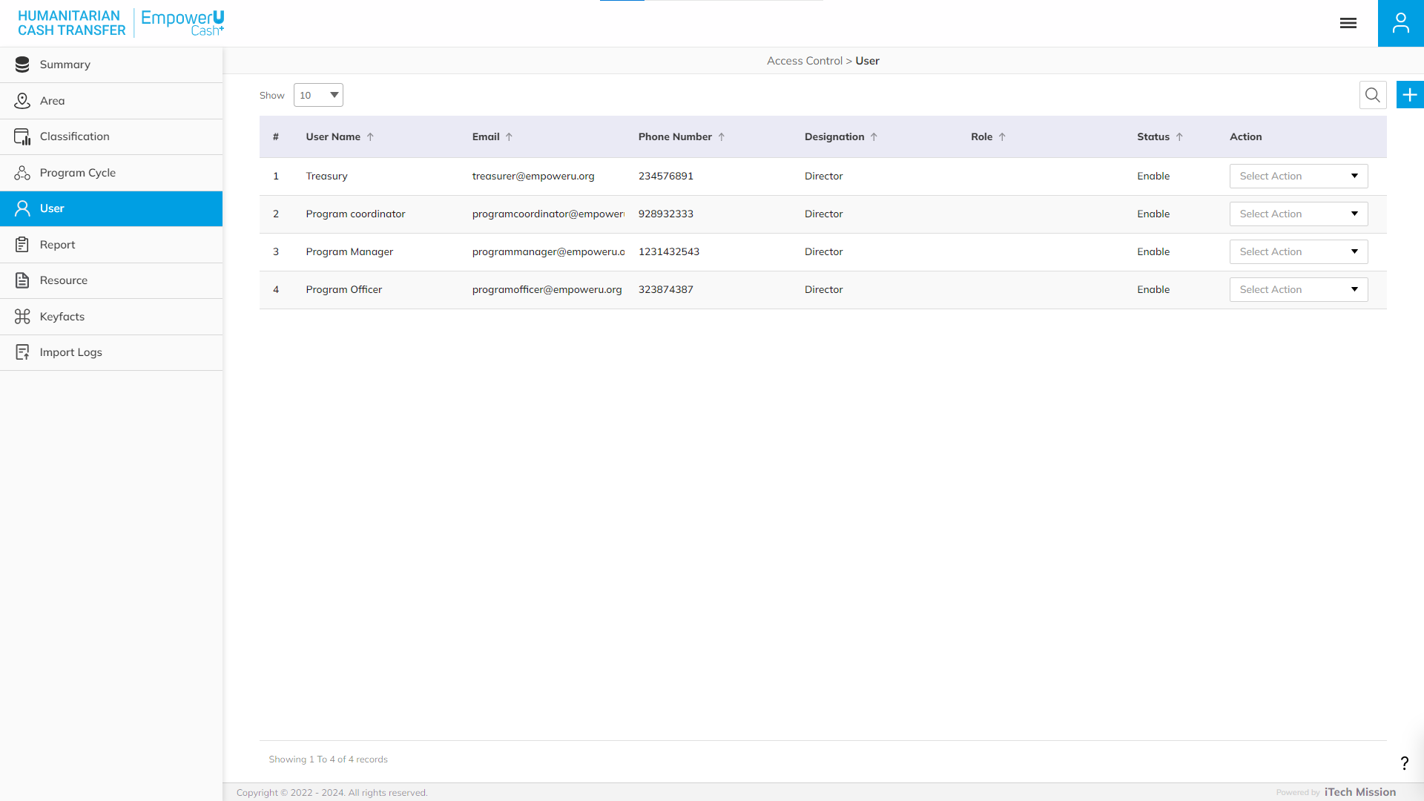
ACCESS CONTROL
View and Search the existing User List. Click on the plus button to add a new user.

Slide 23
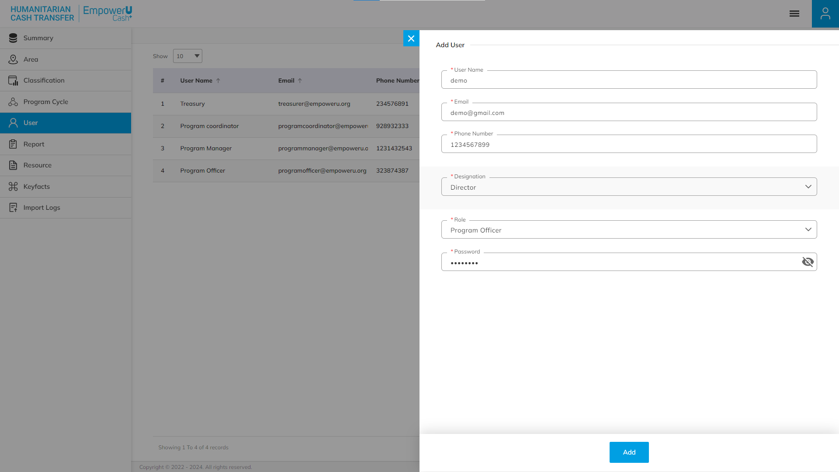
ACCESS CONTROL
Add User Form – Fill in the details – User Name, Email, Phone Number, Designation, Role, and Password. Click Add to confirm & save.

Slide 24
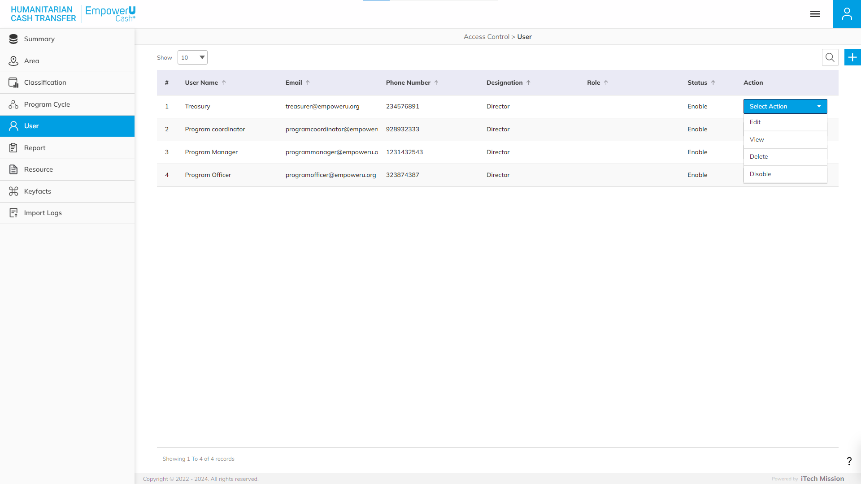
ACCESS CONTROL
Edit, View, Enable/Disable, and Delete the existing User.

Slide 25
6
Report

Slide 26
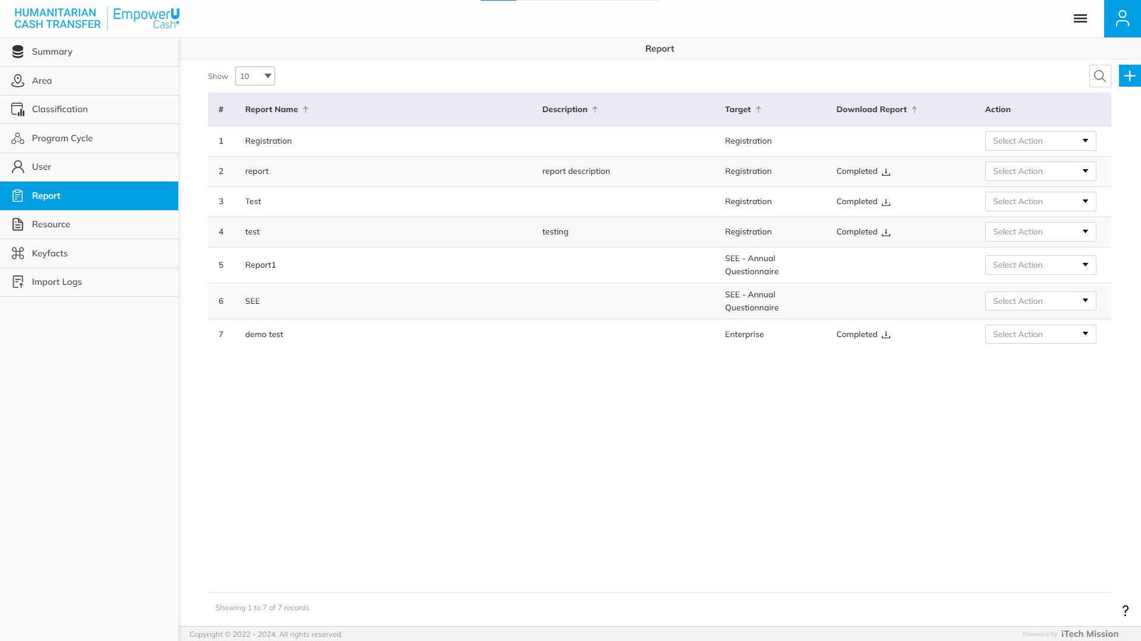
REPORT
View and Search the existing Reports List. Click on the plus button to add a new user.

Slide 27
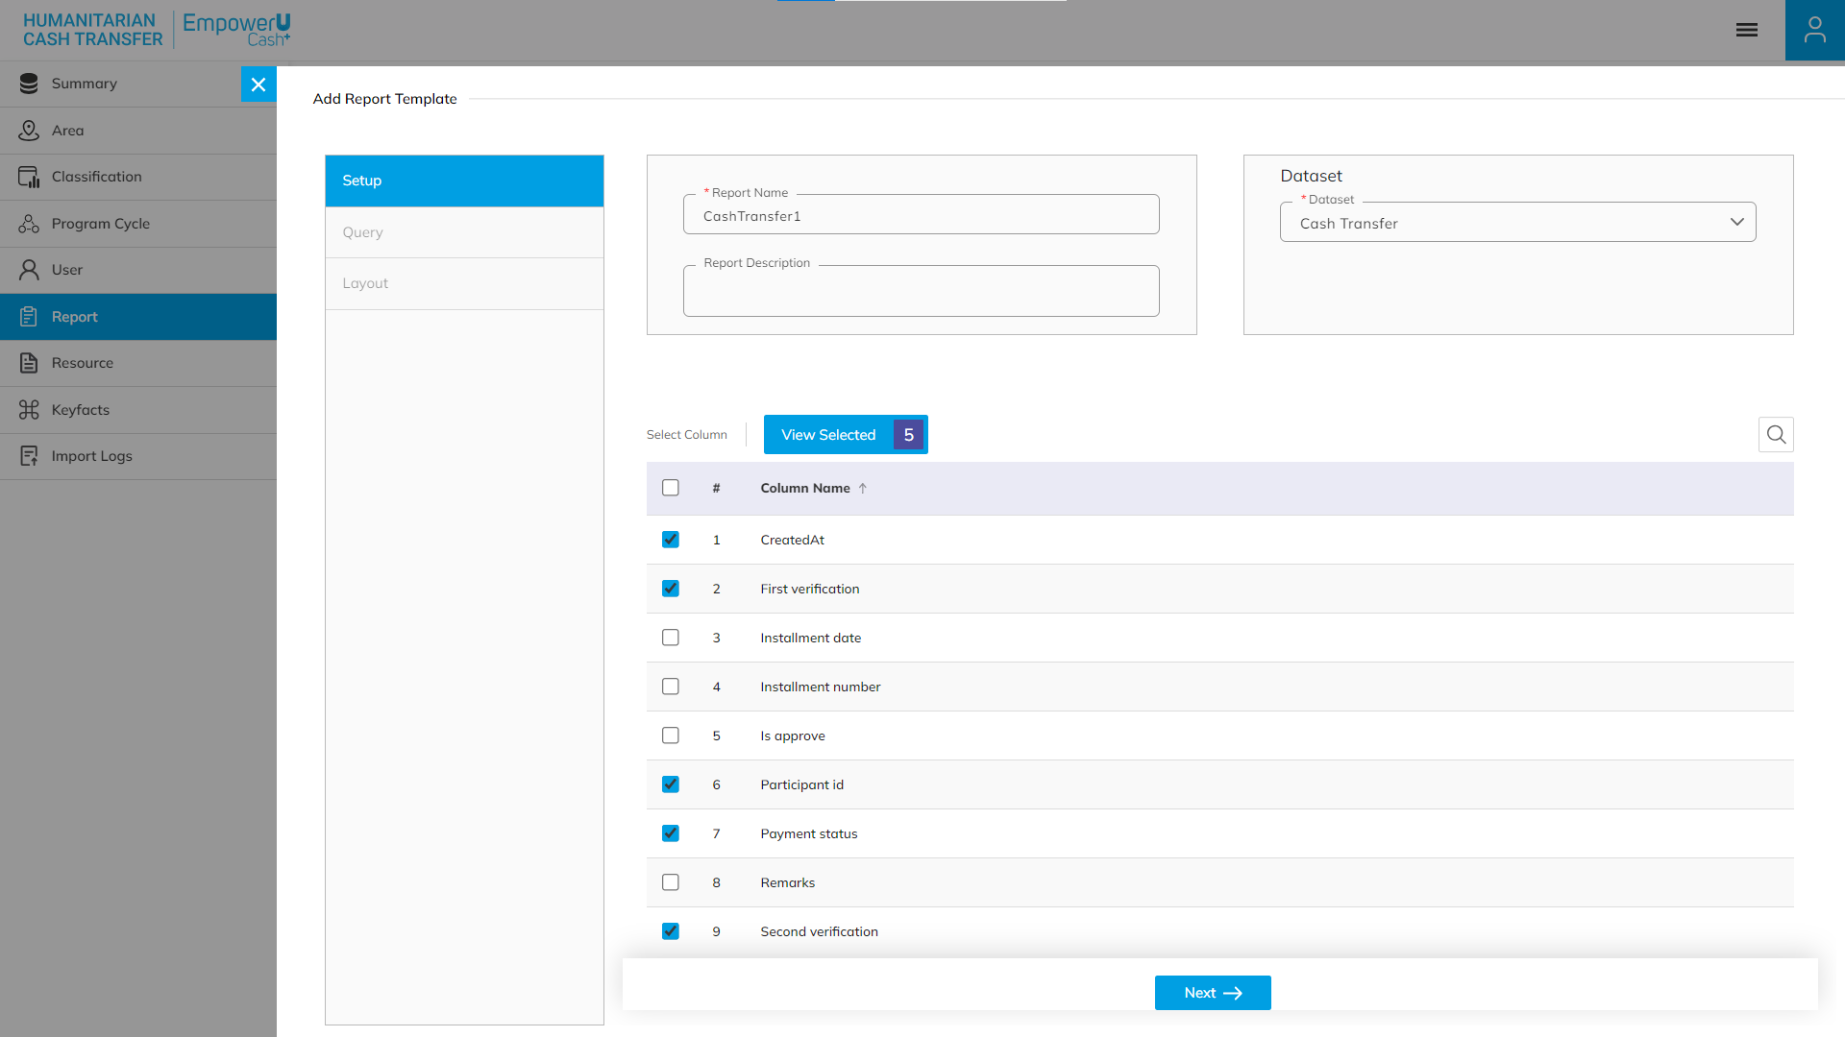
REPORT
Generate Report Form – Fill in the Setup details – Report Name, Dataset, Report Description, and Add columns. Click Next to move forward in the process.

Slide 28
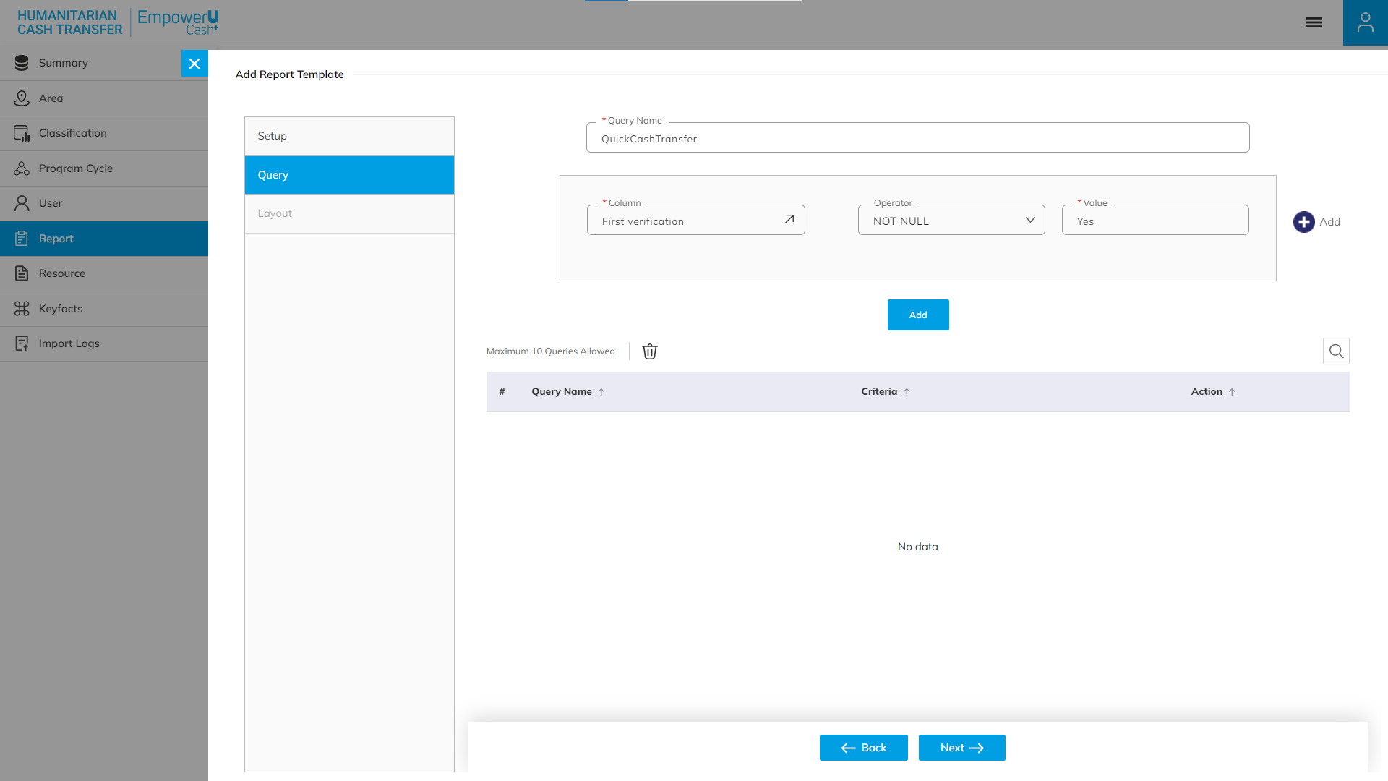
REPORT
Generate Report Form – Fill in the Query details – Query Name, column, Operator, and Value. Click Add to save in Query. Click Next to move forward in the process.

Slide 29
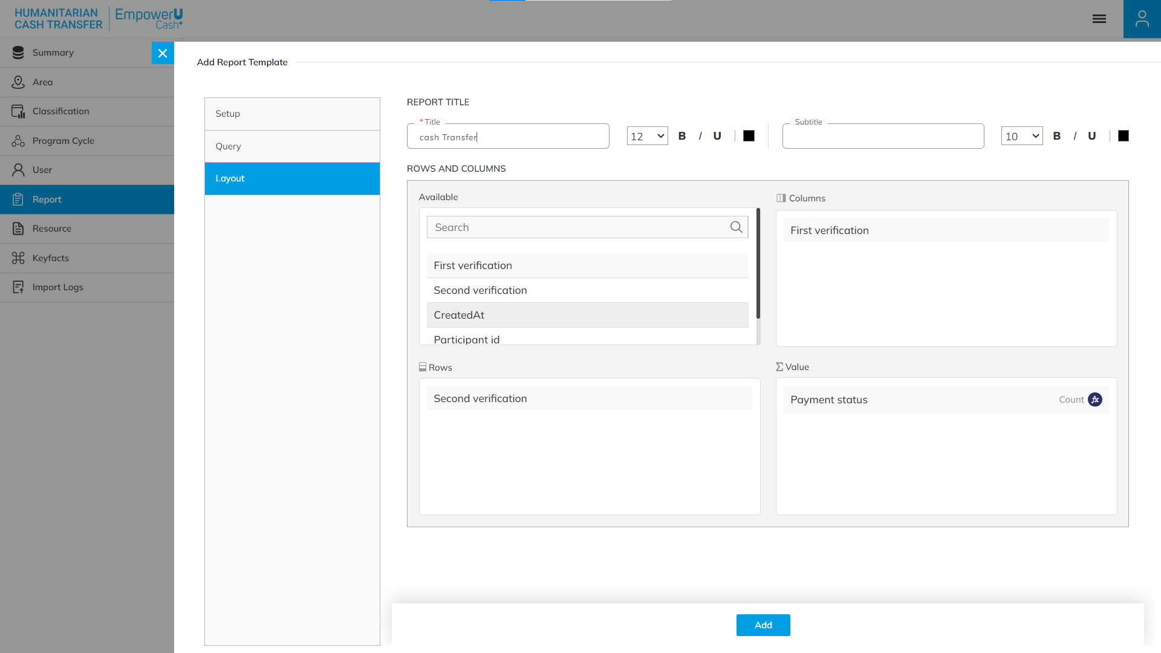
REPORT
Generate Report Form – Fill in the Layout details – Report Title, Rows, and Column. Click Add to confirm & save.

Slide 30
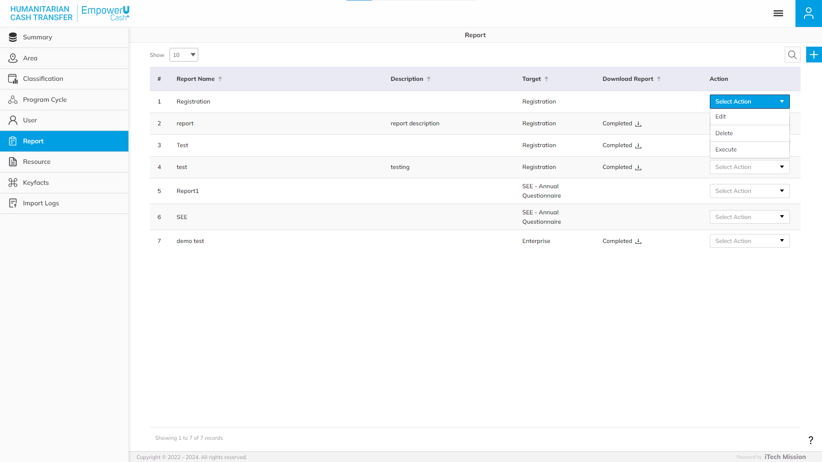
REPORT
Edit, Execute, and Delete the existing Reports.

Slide 31
7
Resources

Slide 32
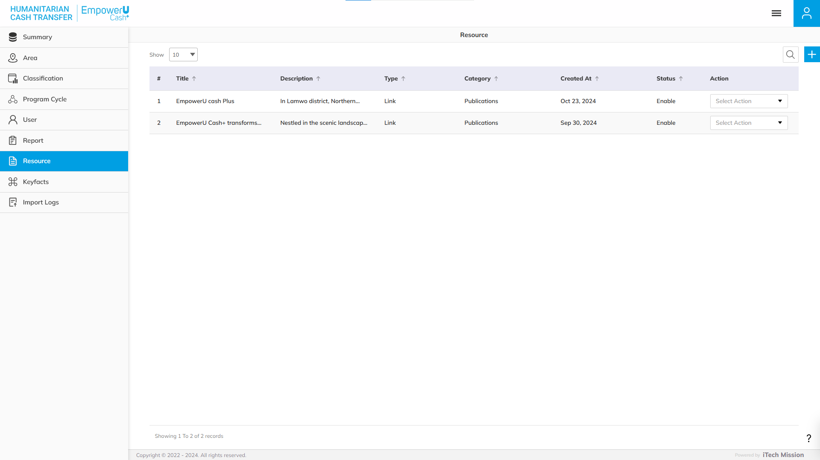
View and Search the existing Resource List. Click on the plus button to add a new resource.
RESOURCE

Slide 33
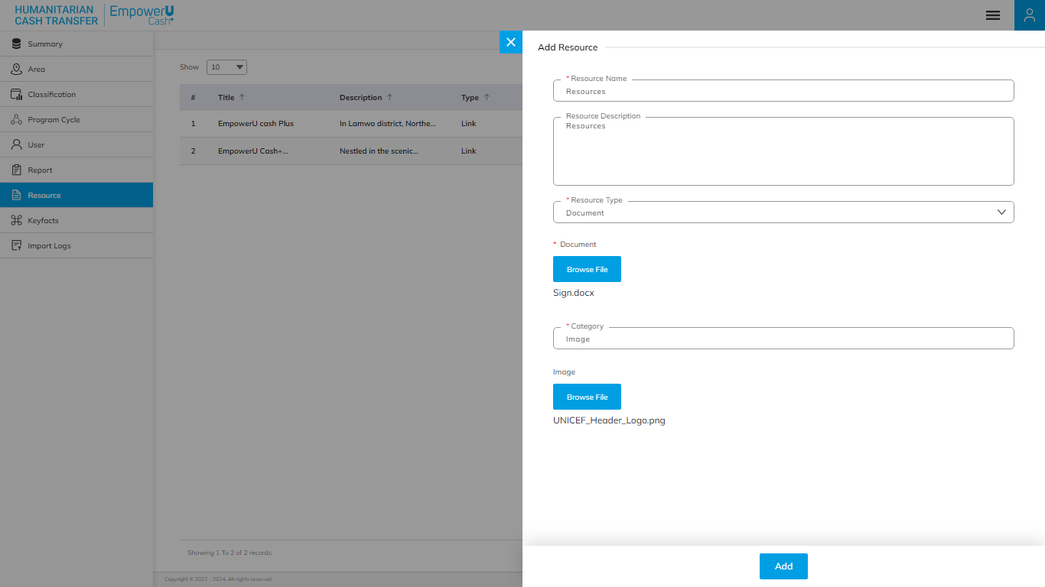
Add Resource Form – Fill in the Query details – Resource Name, Resource Description, Resource type, Insert URL/Upload Document, Category, and Upload Image. Click Add to confirm & save.
RESOURCE

Slide 34
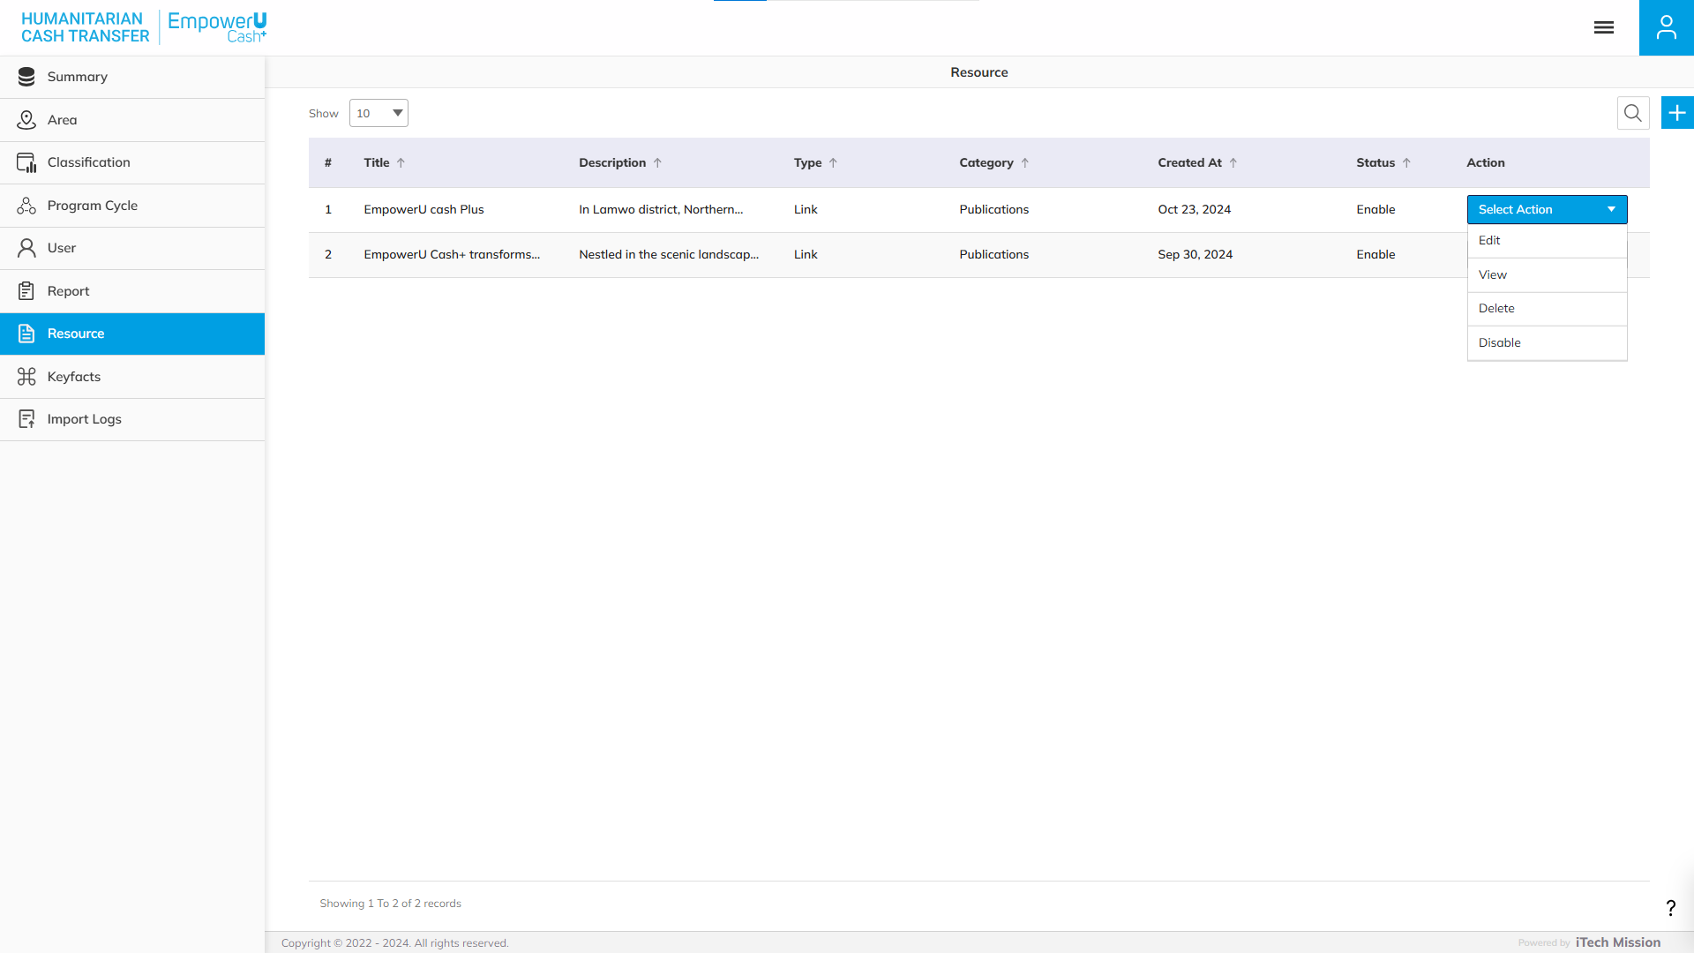
RESOURCE
Edit, View, Enable/Disable, and Delete the existing User.

Slide 35
8
Key facts

Slide 36
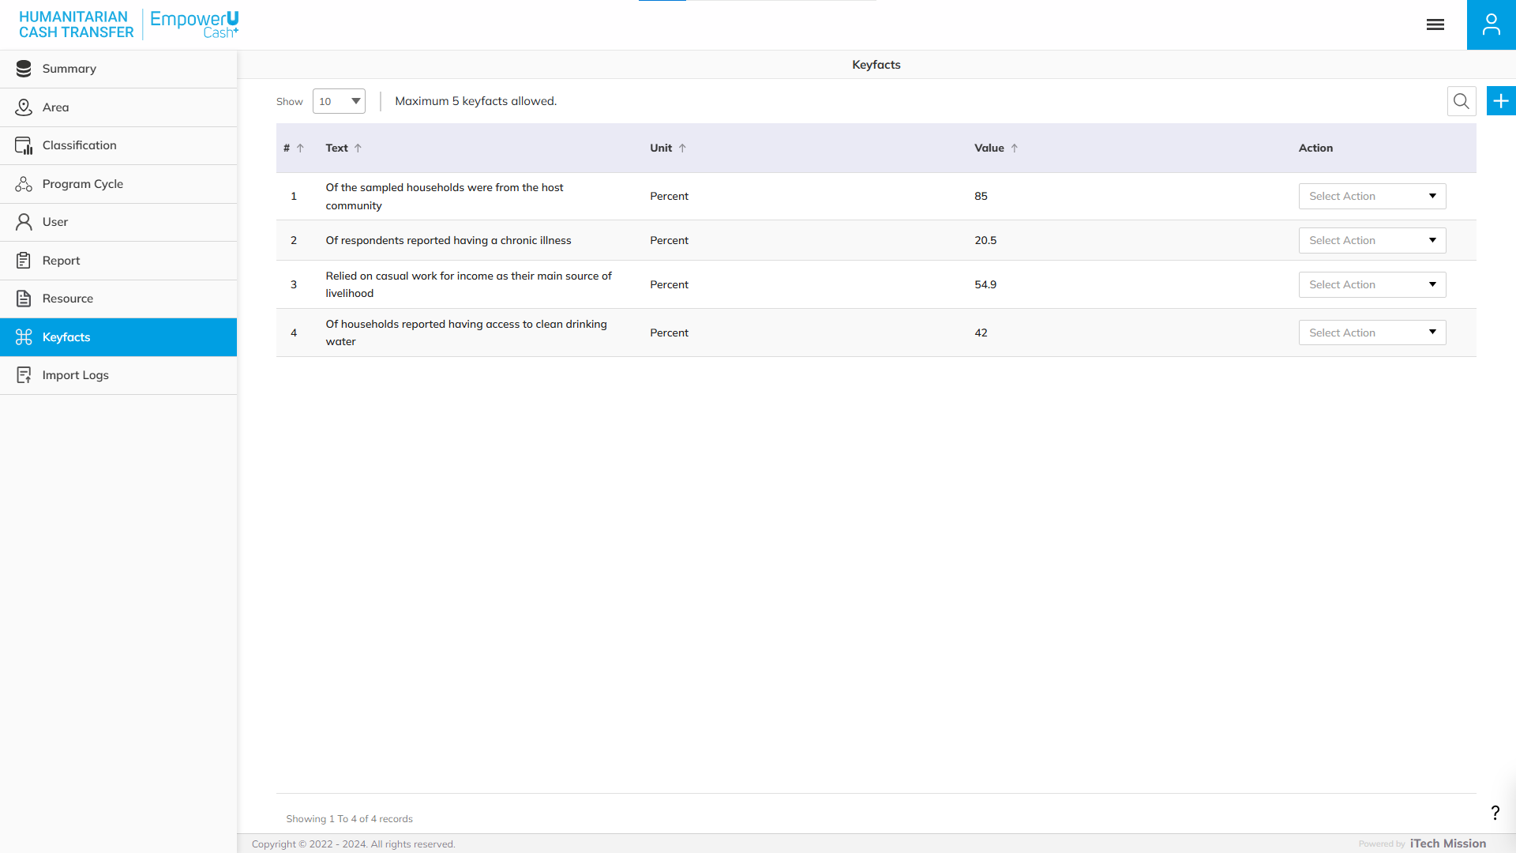
KEYFACTS
View and Search the existing Keyfacts List. Click on the plus button to add a new Keyfact.

Slide 37
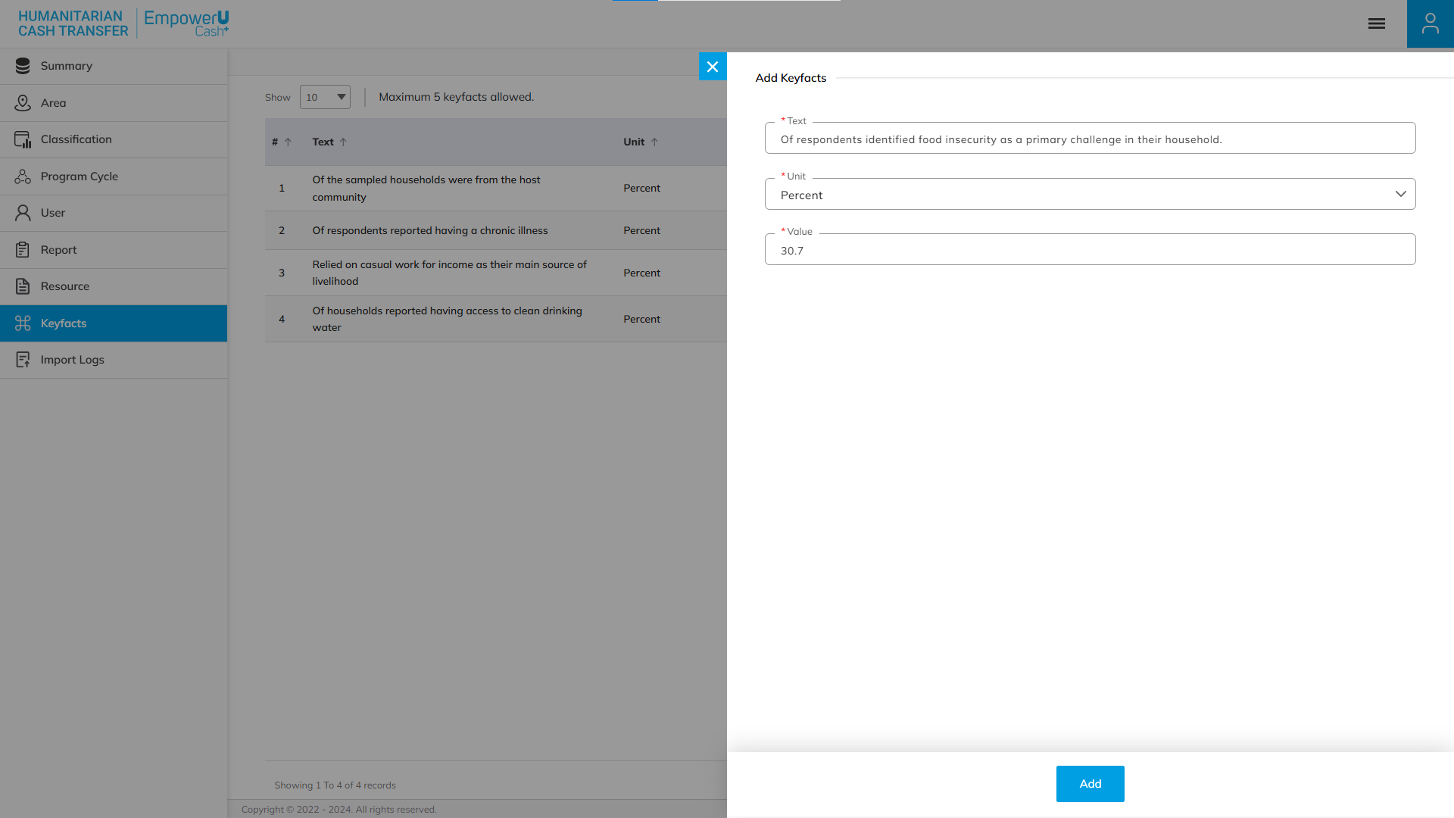
KEYFACTS
Add Keyfacts Form – Fill in the Query details –Text, Unit, and Value. Click Add to confirm & save.

Slide 38
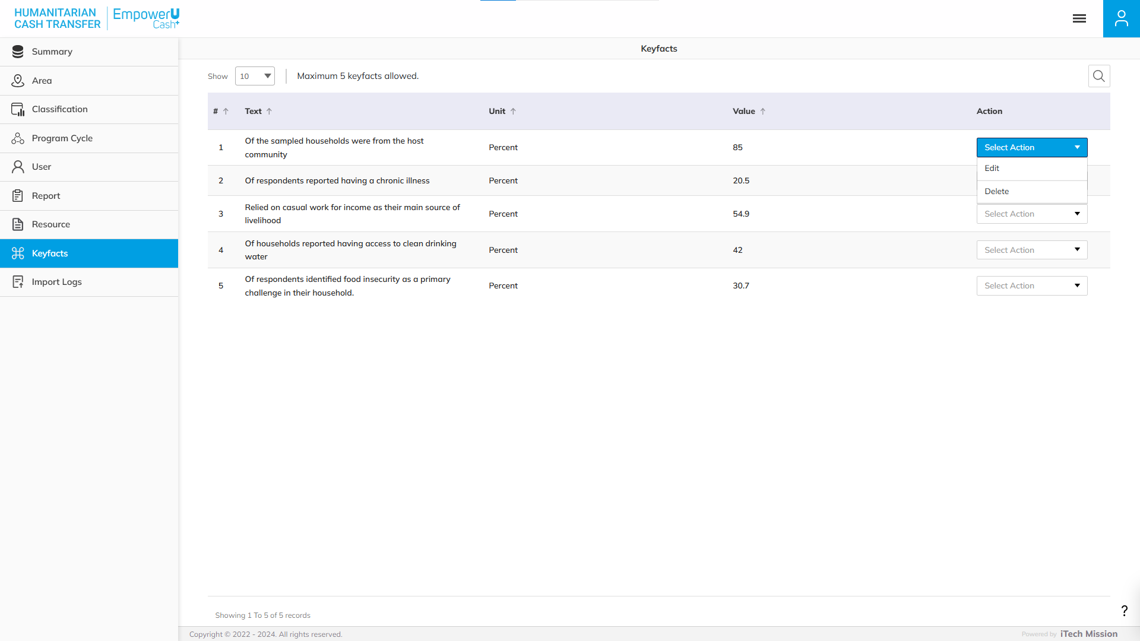
KEYFACTS
Edit and Delete the existing Keyfacts.

Slide 39
9
Import Logs

Slide 40
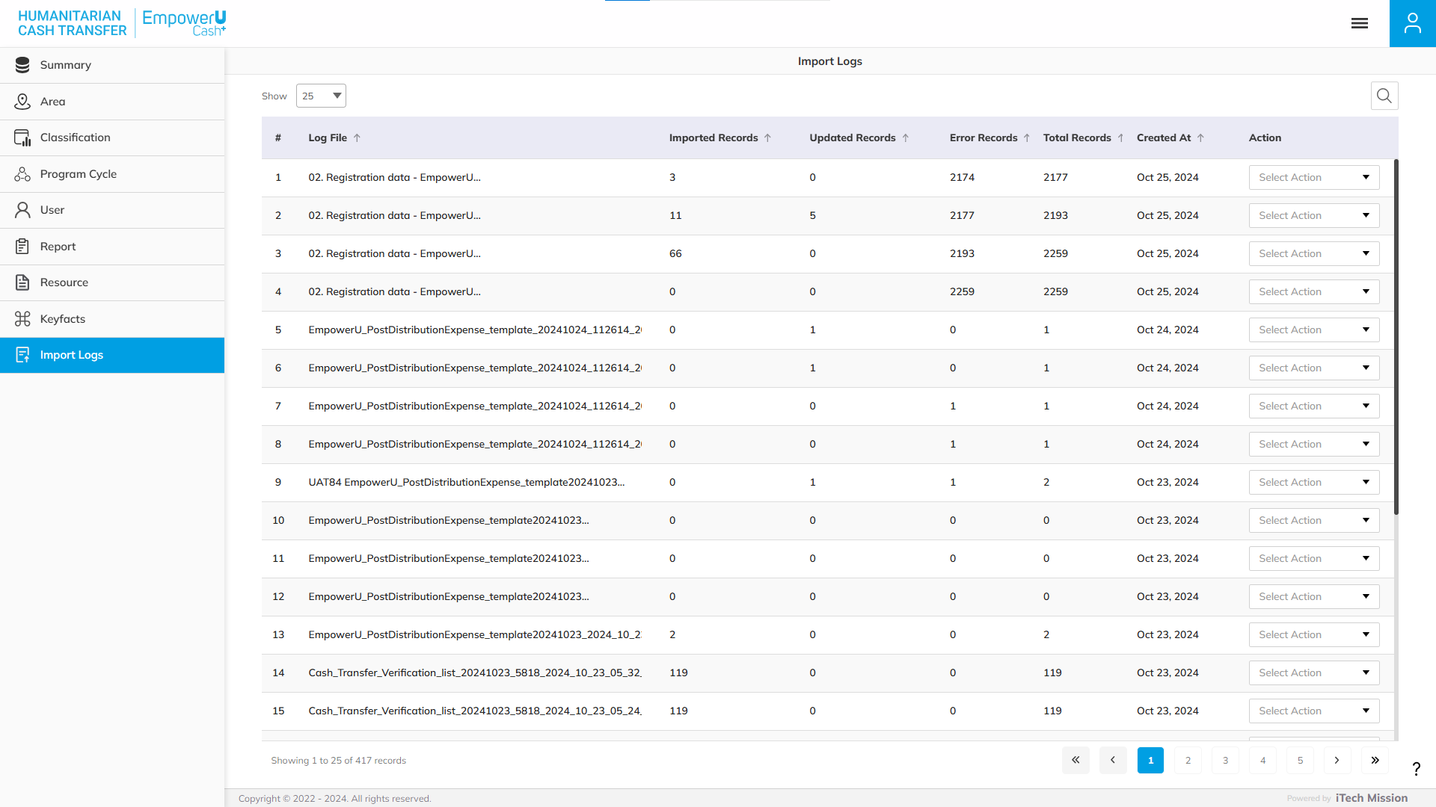
IMPORT LOGS
View and Search the existing Import logs List.

Slide 41
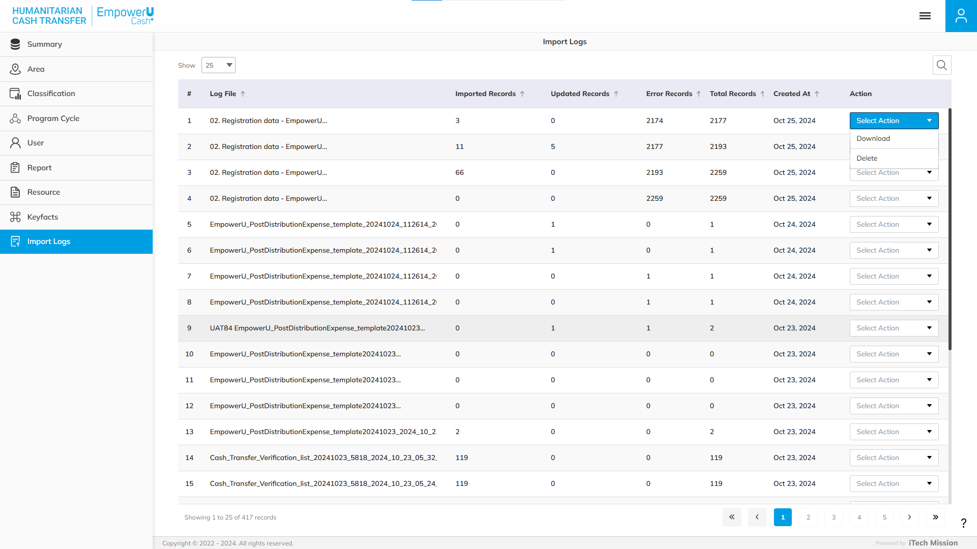
IMPORT LOGS
Download and Delete the existing Import Logs.

Slide 42


